Slide 1
Singleton and Prototype
Lutfun Nahar Lota
Lecturer, CSE

Slide 2
Singleton Pattern
Singleton pattern is one of the simplest design patterns in Java.
This type of design pattern comes under creational pattern

Slide 3
Singleton Pattern
This pattern ensures that a class has only one instance, while providing a global access point to this instance.
This class provides a way to access its only object which can be accessed directly without need to instantiate the object of the class.

Slide 4
Why Singleton
To control access to some shared resource—for example, a database or a file.
Just like a global variable, the Singleton pattern lets access some object from anywhere in the program. However, it also protects that instance from being overwritten by other code.

Slide 5
Singleton Pattern
Make the default constructor private, to prevent other objects from using the ‘new’ operator with the Singleton class.

Slide 6
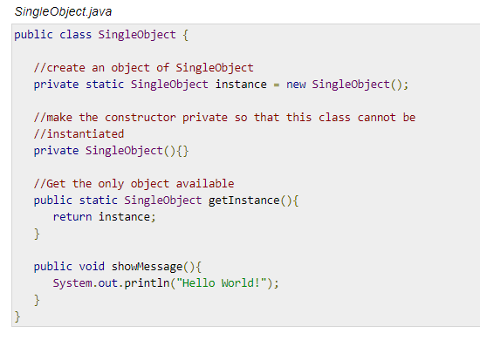
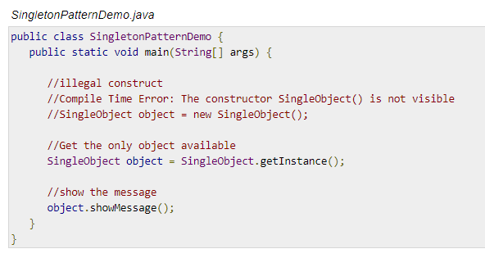
Singleton Pattern

Slide 7
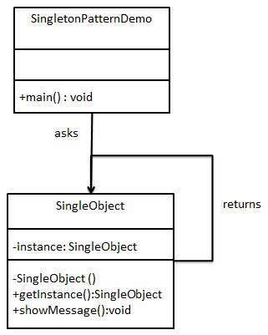
UML Diagram of Singleton Pattern

Slide 8
Prototype Pattern
Prototype pattern refers to creating duplicate object while keeping performance in mind.
This type of design pattern comes under creational pattern
Lets client copy existing objects without making your code dependent on their classes.

Slide 9
Prototype Patterns
This pattern involves implementing a prototype interface which tells to create a clone of the current object.
This pattern is used when creation of object directly is costly.
For example, an object is to be created after a costly database operation. We can cache the object, returns its clone on next request and update the database as and when needed thus reducing database calls.

Slide 10
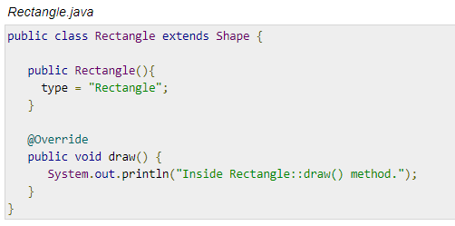
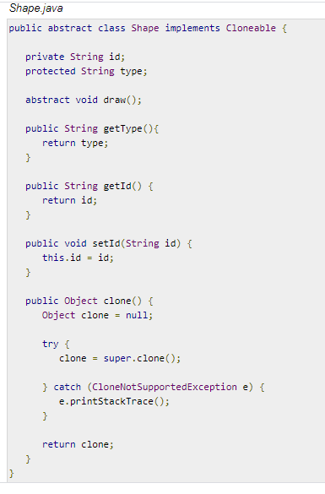
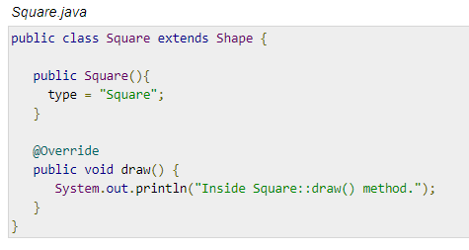
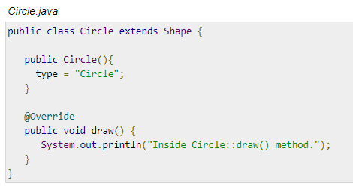
Prototype Pattern

Slide 11
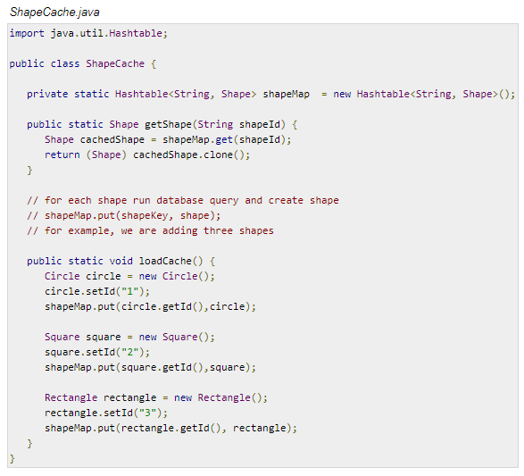
Prototype Patterns

Slide 12
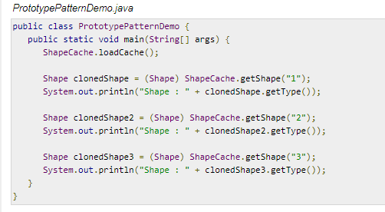
Prototype Patterns

Slide 13
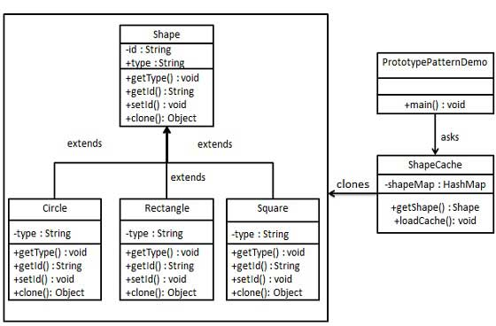
UML Diagram for Prototype Pattern

Slide 14
H/W
Singleton VS Prototype

